Slide 1

SUPERSTORE PERFORMANCE ANALYSIS
Team Octave
Date: May 27, 2022

Slide 2
Table of content
1. Introduction
2. Background
3. Methodology
3. Analysis
4. Forecasting 4. Result 5. Insights 6. Conclusion and Recommendation

Slide 3
Introduction
A Superstore Giant based in the United State has launched different stores across four(4) regions in the country.
They supply products such as Furniture, Office Supplies and Technology, targeted towards three(3) segments of customers - Corporate, Consumers and Home Office.

Slide 4
Background
With growing demands and cut-throat competition in the market, the store is seeking knowledge in understanding what works best for them.
Based on the dataset provided for the period 2014 – 2018, they would like to understand which products, regions, categories, and customer segments they should target or avoid.

Slide 5
Methodology
Approach and Timeline
May 9, 2022
May 10, 2022
May 22, 2022
May 24, 2022
1
2
3
4
Data and Requirement Gathering
-Data collection
- Understanding the business problem
Data Cleaning
-Exploratory data analysis
-Data quality issues
Data Analysis
Visualization
Analysis
Reports
Insights
Recommendation

Slide 6
Analysis
Data collection
The data used for this analysis was provided by Octave data team on 16th May 2022 .
Exploratory Analysis
Exploratory data analysis was performed in order to identify the quality of data such as identification of possible missing values, creating new variables from existing columns, converting the data types of variables as needed.
Additional manipulation of data included converting the sales and profit columns(represented as text ) into numerical columns and converting such columns as ship date and order date into date fields as well in order to understand and explain the dataset as a whole to generate possible insights that will aid the analysis .
Visualization
After the data quality check, the clean data was imported into Microsoft Power BI to build visualization and help to better understand the business problem.

Slide 7
Forecasting
We went further to provide more business insights by building a forecasting model to predict sales for the next two(2) months

Slide 8
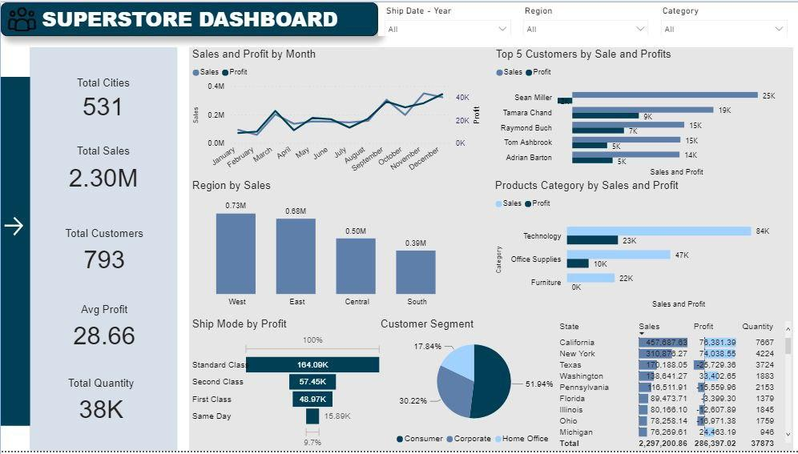
Analysis
Superstore Performance Dashboard

Slide 9
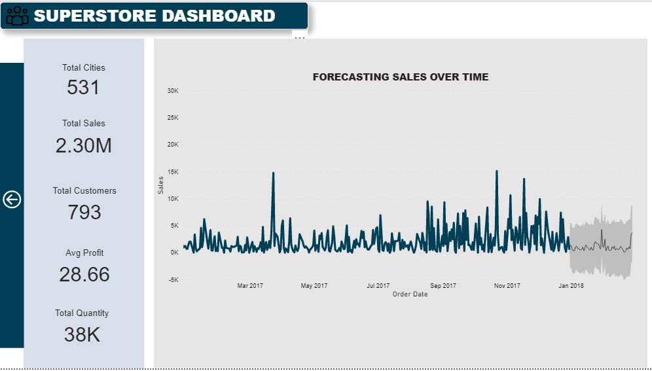
Analysis
Superstore Sales Forecast

Slide 10
Result
The dataset used for this analysis contains 9,994 records and 21 variables. Based on the insights from the dataset, It was discovered that the superstore supplied products to a total of 531 cities in the united states and made a total sales of $2.30million, supplying 793 customers with an average profit of $28.66.
The Line chart depicts that the sales is directly proportional to the profit, which implies that profit increases as sales increases. In January, the cumulative sales for the period under review stands at $94.924.84 with a profit of $9,134.45 and this increases as the month progresses in the year. Although the highest sales was made in November , more profit was generated in December. The least profit was generated in January, which could be as a result of the aftermath of the holidays – the Christmas and New Year Celebration.
A simple pie chart shows that the Consumer segment generated more profit than the corporate and Home office category. This is because 51.94% of the client population belong to this category and majority of products sold are bought by customers in this category with 50.56% of the total sales. Further analysis shows that majority of the products sold by this company are tailored towards this category’s need (e.g, accessories, phones, furnishings, e.t.c) and these consumers tend to buy more than the other customer segments.
The product categories with the highest sales and profit alike is technology. This is because, the Canon imageCLASS product which belongs to the Technology class is driving more sales and profit than any other product although it is not.

Slide 11
Result
the product with the highest quantity being sold.
California, New York, Washington, Michigan and Virginia are the top five(5) states that are generating profit. These 5 states have the highest number of customers, quantity of product sold and sales. Further analysis shows that the region with the highest sales and generating the highest profit as well is West, followed by East, by reason of the fact that California and Washington states belong to the west region.
However, States like Texas, Ohio, Pennsylvania, Illinois and North Carolina are generating the negative profit i.e such states have the highest loss even with high number of customers and large number of products being sold. This could be that a large of number of products generating little profit are being sold and customers in this states are not buying expensive products.
The Matrix table shows that Phones, Chairs and Storage subcategories have the highest sales and a large number of quantities being sold but not necessarily resulting in highest profits. However, subcategories like Copiers and Accessories generated more profit even when the quantities sold are just few.
Subcategories like Tables, Bookcases and Supplies are making a lot of sales but generating losses to the company. This could be that these products have been discounted and are being sold below cost price.

Slide 12
Conclusion
The prices and discount on products generating losses to the company should be reviewed as some states sell more of this everyday products and mainly run at a loss. However, if after the review and there is no positive improvement, such should be avoided and resources from these products should be rechanneled to other category of products generating more profits.
Also, attention should be given to products that generate more profit for the organization even when such products are not bought very frequently. This could be achieved by recommending such products to the customers. Carrying out sales promo, especially in the regions and states with lowest sales as well as after-sale services to encourage patronage from various customer segment.
More importantly, We will advice that modalities should be put in place to check the re-order level of the products in high demand, especially towards the year end where there is usually huge patronage and sales in order to avoid stock-out, which will negatively affect the sales value of Superstore.

